Slide 1
What we know about Creating Change
Sharon Benjamin Ph.d.
sharon@sharonbenjamin.com

Slide 2
What We Know about Creating Successful Change
  Organizations are complex systems where all the parts interact and affect each other.
  Changing patterns of interactions makes it possible to positively influence results in a complex system.
  Invite self organization to flourish by letting go of OVER-control.
  Expand and connect networks by breaking down silos.
  Increase the number and strength of network ties.
  Build whole new sets of feedback loops via many new forms of interaction.
  Increase resilience by engaging more people and perspectives.
  Create favorable conditions for emergence through joint-discovery in groups.
  Generate non-linear impacts as small changes yield surprisingly big impacts.

Slide 3

A 2004 study of 49 published reports of organizational change, found that only
of change effort were successful
33.3 %
!
Smith, Martin; Performance Improvement; January 2004

Slide 4
Classic Change Models:
Widely Used but Not Sufficient
Establishing a Sense of Urgency
Creating the Guiding Coalition
Developing a Vision and Strategy
Communicating the Change Vision
Empowering Broad-based Action
Generating Short-term Wins
Consolidating Gains & Producing More Change
Anchoring New Approaches in the Culture

Slide 5
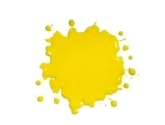
Because
More recent studies show more of the same failure rates

Slide 6
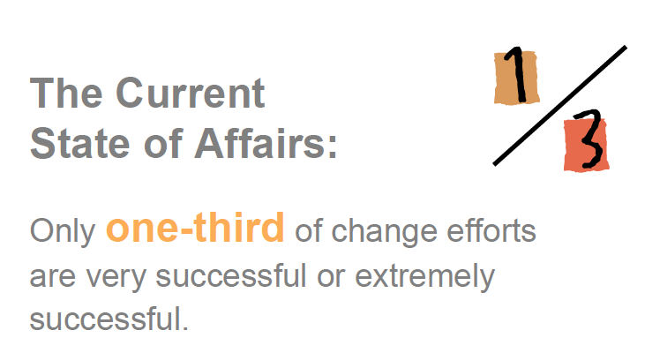
Source: McKinsey & Company study 2008, survey of 3,199 executives

Slide 7
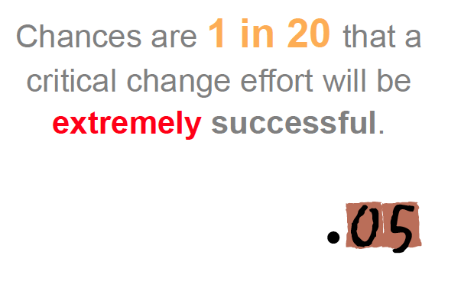
Source: McKinsey & Company study 2008, survey of 3,199 executives

Slide 8
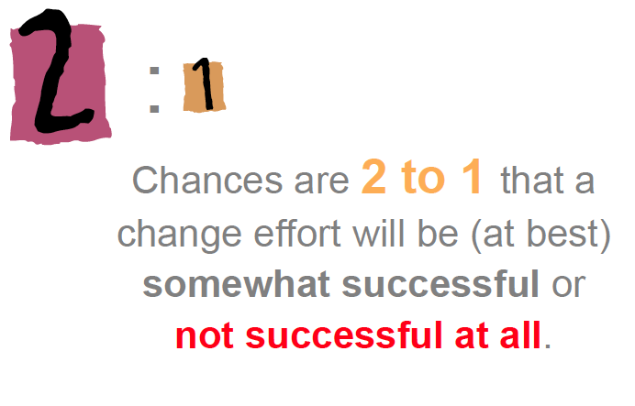
Source: McKinsey & Company study 2008, survey of 3,199 executives

Slide 9
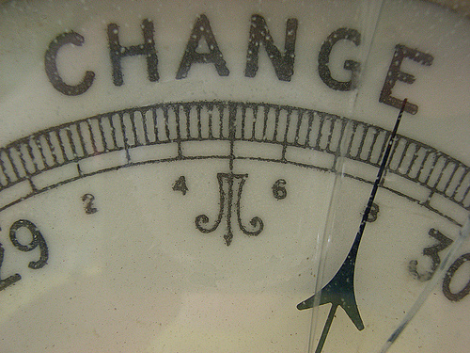
We need to use new approaches
CHANGE

Slide 10
Emergent Change Research
Type of Organization | Sample & Data | Focus of Research
Financial Services | 32 interviews & archival data | Analyzes the dynamics of idea generation and idea flow
Medical Equipment | 16 interviews | Interactive dynamic of informal networks on emergent change
Aerospace | 25 interviews | Examine the conditions for emergence of complexity dynamics
Financial Services | Network Analysis 60 Respondents | Social network analysis to identify network structures associated with change
Financial Services | 80 participants social interaction analysis | The power of cohesiveness within micro networks in idea generation
Hospitals | 25-hospital collaborative | Improving clinical practice to prevent healthcare acquired infections through learning networks
Pure Research
Action Research

Slide 11


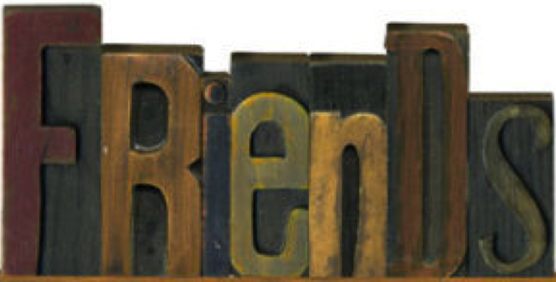



spreads
really matter
need to
maintain
Notes:
If you want to me interesting, you better be interested … if your bored … guess what
even contagious … good ideas take hold … good ideas with passion soar
The Most Valuable People in Your Network ~ Rob Cross U VA … The secret to these networks has never been their size … quality.
Dunbar rule of 150 says … he who seeks to change the existing order … lukewarm supports … unless they are freinds
Build relationships before you need them and ask them to help you … social capital … not exposure.
3. Brand your passions … focus on boundaries and concentrate your efforts … be a magnet

Slide 12
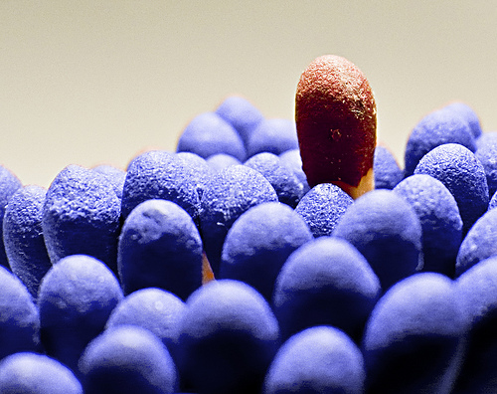

spreads
To be interesting, you must be interested
Passion & Conviction are Contagious
Notes:
You have got to find what you love … the only way to do great work is to love what you do
… drop out to drop in
Tenacious as Hell

Slide 13

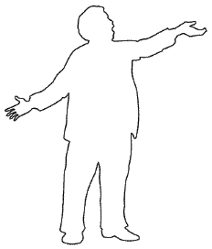
Face-2-face
Passion Spreads
As much as 70-80% of our ability to influence is a result of face-2-face exchanges
Pentland, S. (2009), Honest Signals

Slide 14
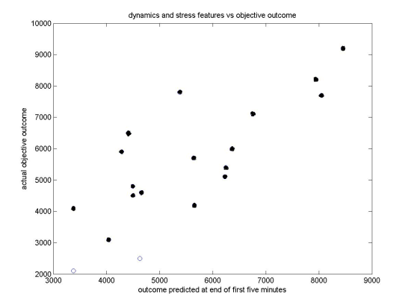


F2F Interactions drive Influence
your pay
Sales, salary negotiation:
up to 30% increase
your signals
Social Signal prevail over business case -
86% accuracy
Dating signals that work at 75% accuracy
2300 hours of experiments with 800 people
Notes:
46 pairs of mid-career professionals role-played the negotiations of a salary package between a candidate and the hiring manager. The discussions ranged from 10 to 80 minutes in length,
From the first two minutes of a conversation
Venture capital-Sloan fellows program pitching real business plans … 86%
Speeddating-looking at three minutes worth of a conversation we could project who would exchange information
75 percent accuracy rate .... The women were in dominance. Also interestingly the men only shared their information with women who are willing to share with them. Even though they didn't know that.
the chance rate is 15%.
Interestingly the male signals didn't matter
Salary negotiations-mid career professionals in a lab study were asked to negotiate with another person to maximize their salary and benefits. you to predict with high accuracy rates whether not a person will be successful.
. Depending on how fluid and exciting the presenter was are looking at consistency and attention you could determine which plans were going to be accepted or funded. These predictions were content neutral

Slide 15
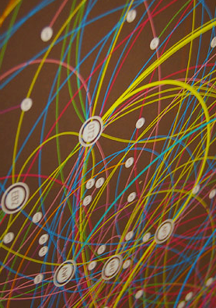

really matter
Tap into your
to build momentum
Notes:
You need relationship before the idea comes

Slide 16
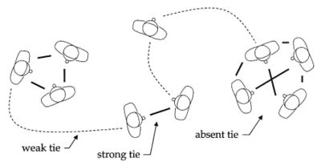
Your strong ties provide cohesion;
driving influence
Your weak ties provide richness;
creating insights
Notes:
You need to develop both

Slide 17
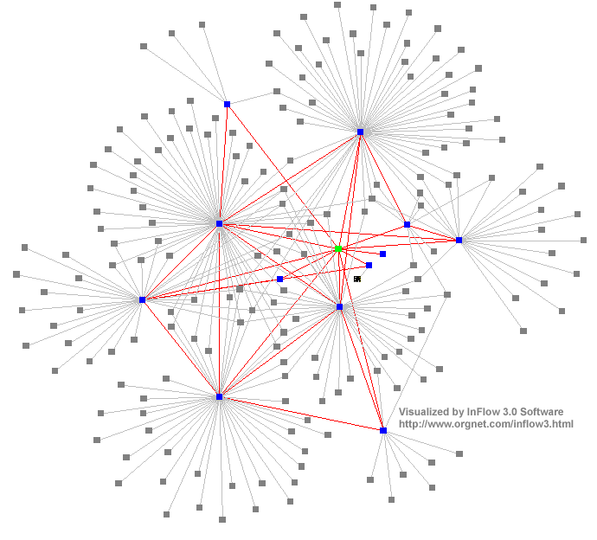
Discovery vs. Influence
Loose networks (weak ties) help discovery
produce 25% more insights
Cohesive networks help influence change
improves productivity by up to 30%
Best Research Paper, ICIS 2008
(Wu,Waber,Aral,Brinjolfsson,Pentland)
Notes:
These types and networks are 20% faster yet produce 25 percent less ideas
If you need to better brainstorm choose one model or to want to make faster decisions choose another.
Oscillation between face-to-face and central create creative idea
Different media has a different role-expiration and integration
E-mail an instant messaging were great in communicating fact and declarations.
Rich media or face-to-face were far better in communicating tacit information
A standard deviation improvement of one provide 7 percent better productivity in each channels
A standard deviation improvement of one provides 30 percent better productivity in face-to-face or influence in channels

Slide 18


need to
maintain
Concentrate your Powers and Efforts
Change spreads in cluster not through hierarchies
Notes:
Nucor … maintenance outage
Kitsurfing …

